Slide 1
EECS 4720/5720: Fundamentals of Cyber Security
Lecture 1

Slide 2
Preliminaries
Prerequisites
Basic programming in UNIX environment (C, C++)
Operating Systems Basics
Computer Network Basics
Course Policy
Attendance
Participation
Academic Integrity
Textbook
Ross Anderson, Security Engineering. 3rd Edition. John Wiley and Sons. 2020
Course Webpage (Blackboard)
Lectures Slides
Assignments
Hands-On
Projects
Exams
Mid-term: 7th week (Feb 28/Mar 2)
Final: Exam week (May 2)
Grading, Contact and more in the Syllabus (On Blackboard)

Slide 3
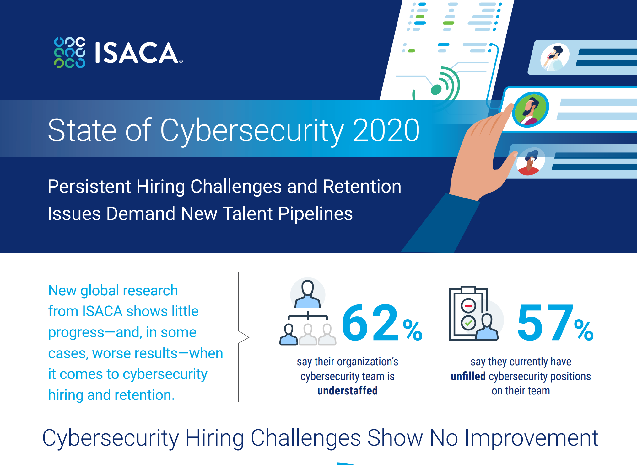

Slide 4
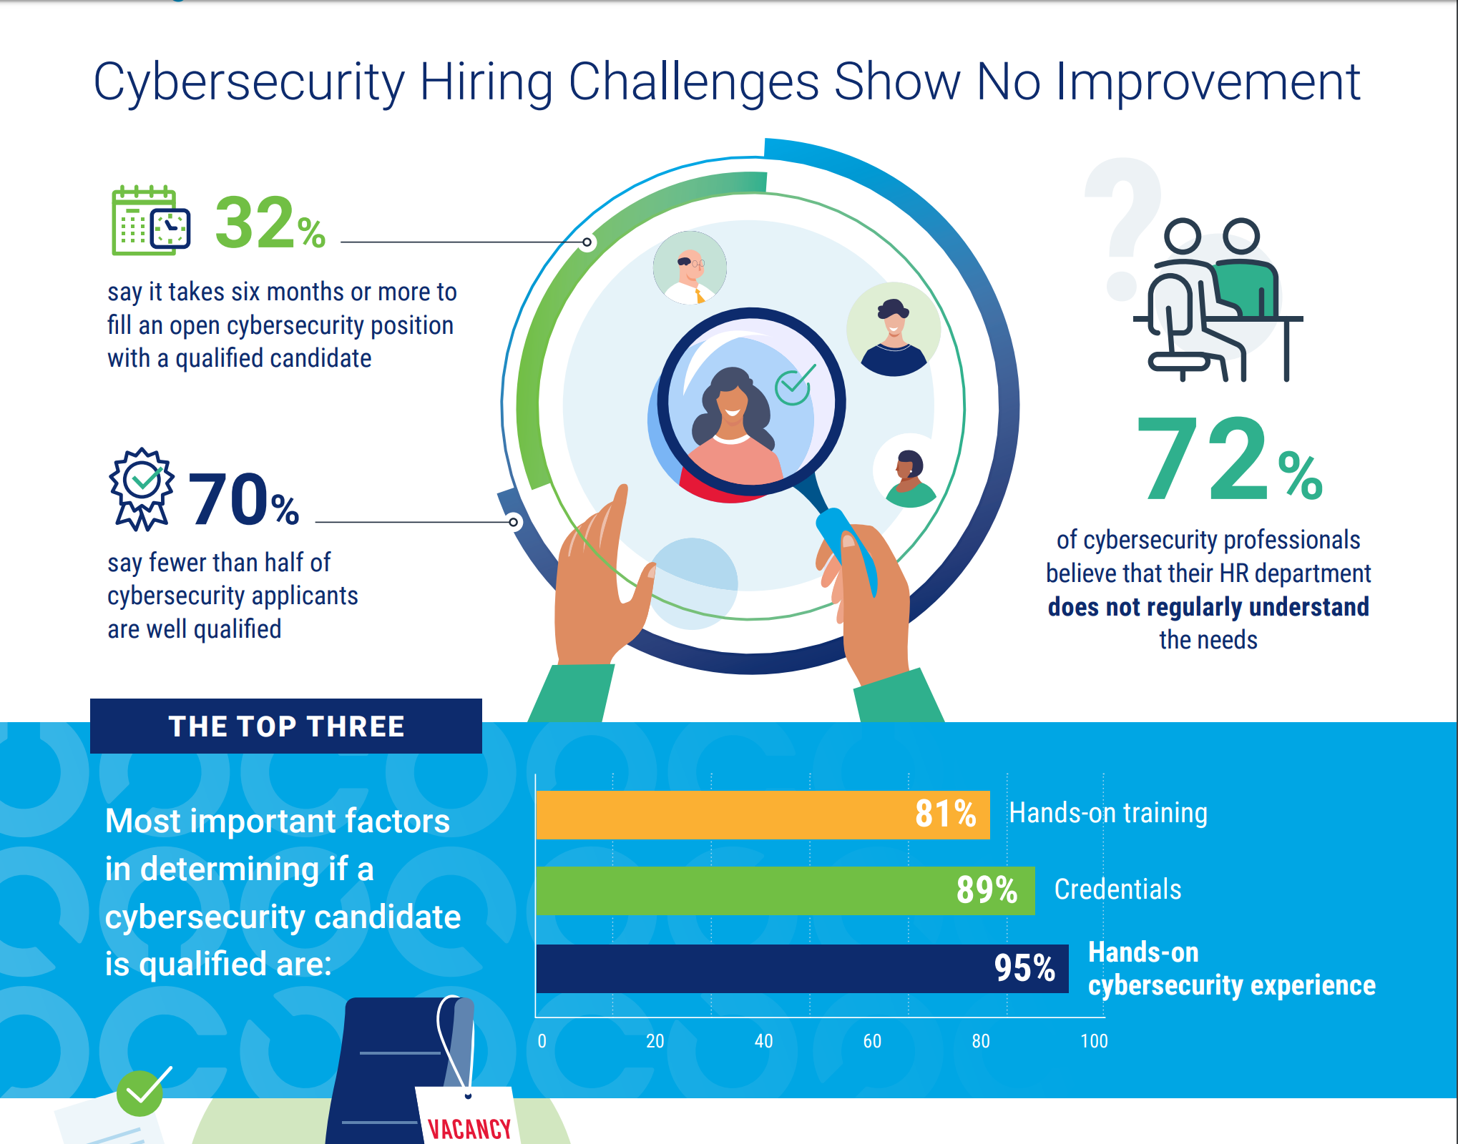

Slide 5
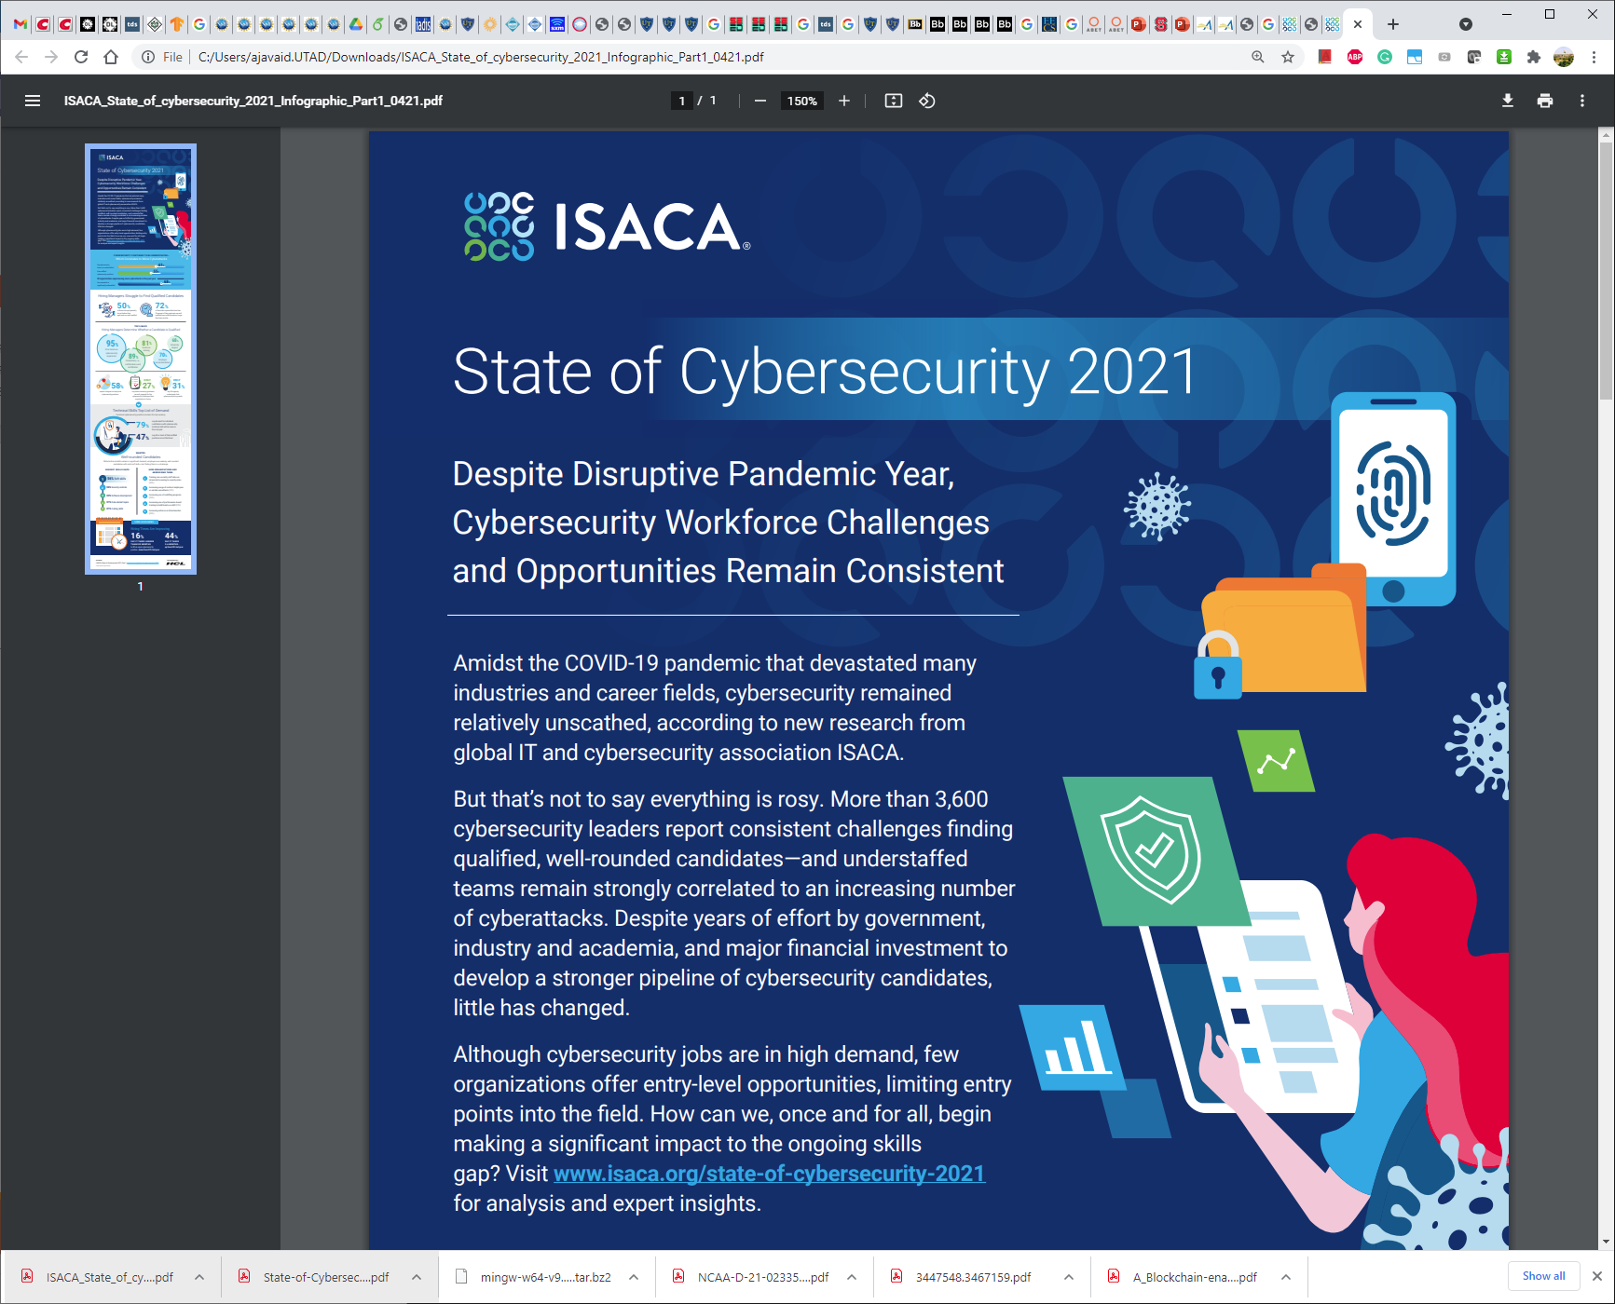

Slide 6
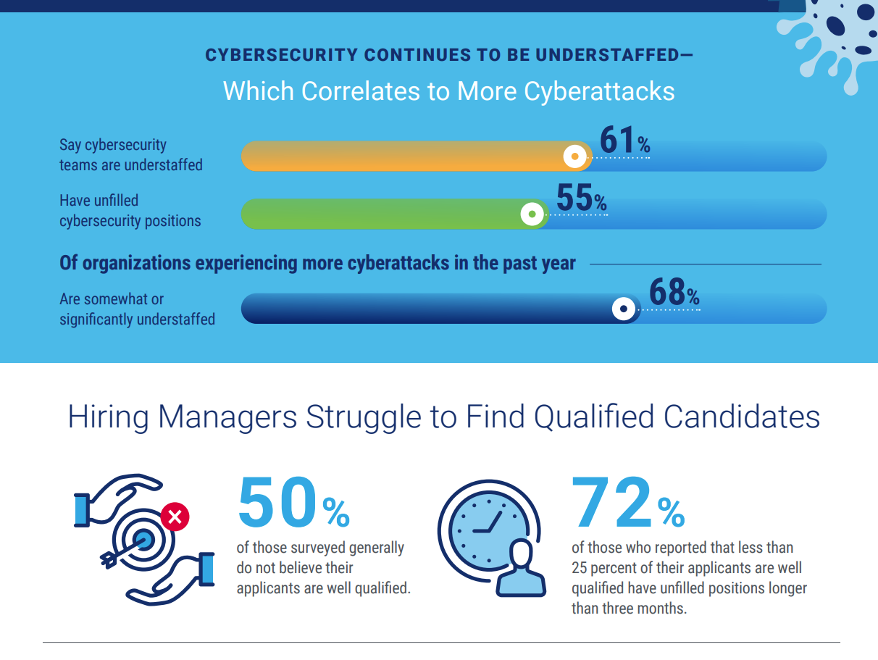

Slide 7


Slide 8
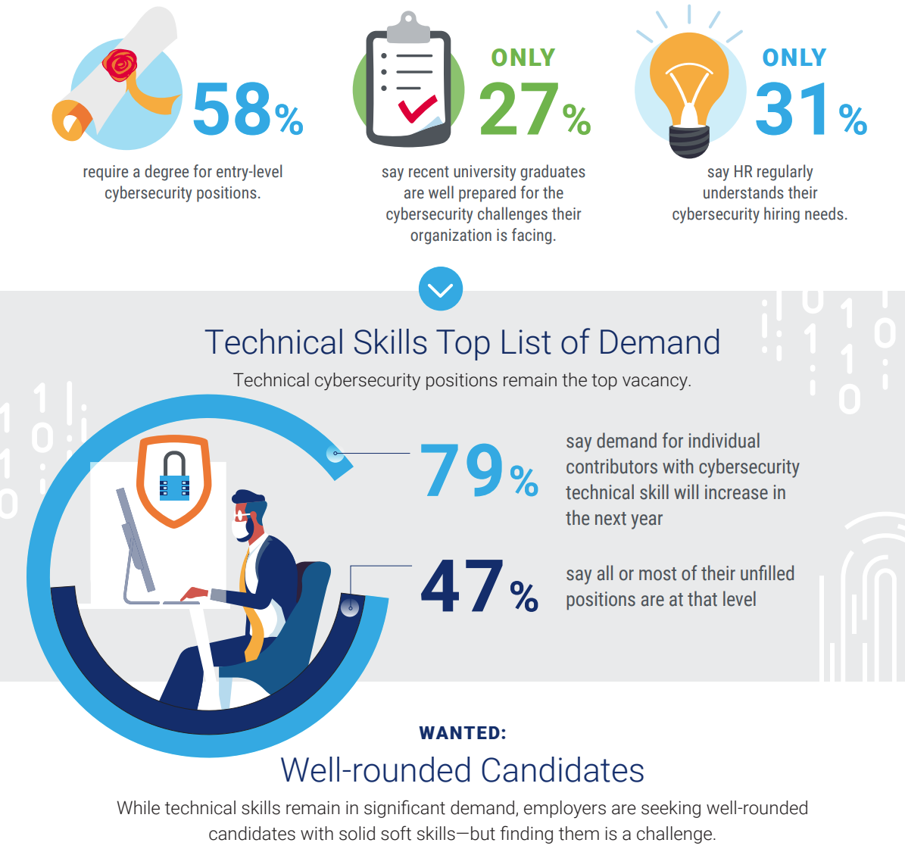
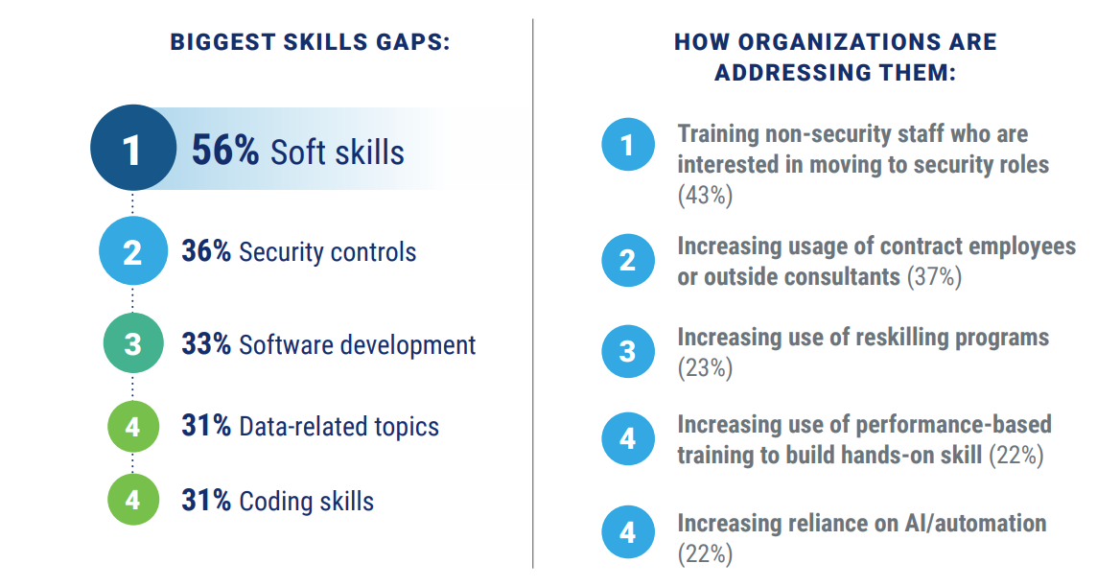

Slide 9
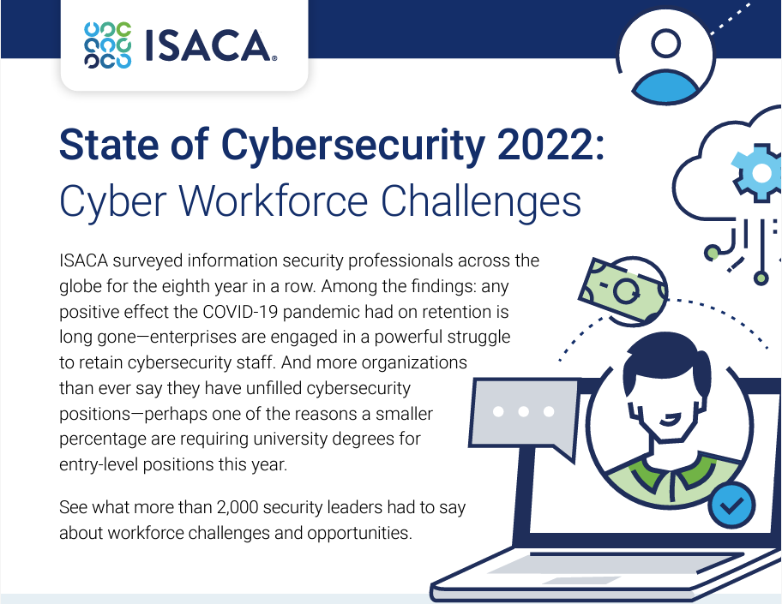

Slide 10


Slide 11
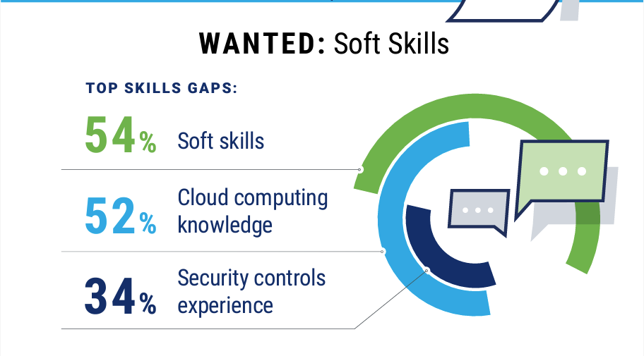

Slide 12
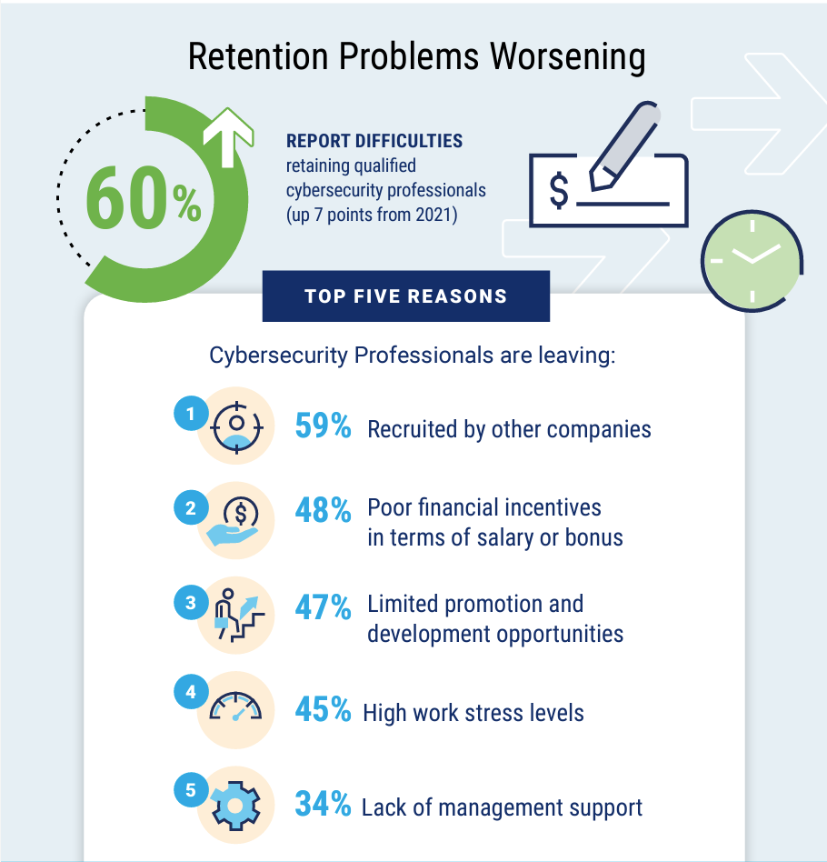

Slide 13
What will you learn
Basics of computer security
How to secure an existing system and/or build a secure system
Security mechanisms such as Encryption
Software, Network and Web Security
Get a feeling of real-world security problems
Hands-on assignments
Business Perspective
“Researching” a topic
Possibly … Continue to get a Cybersecurity Certification
CompTIA Security+, CEH, CISSP, CISM, GSEC, CISA, etc.

Slide 14
What will you NOT learn
Become a pro Hacker
Write/design/build invulnerable code/software/system
Exploring the dark web

